Slide 1
Introduction to Structural Design
Nihar Shah
Abhinav Sridhar

Slide 2
Structural Design
Structural design enables us to have a modular design
Such a design helps in division of work, and makes designing process slightly easier

Slide 3
Component Declaration
Inside the architecture block, we declare components along with signals
The component must have the same port names and order as the entity we are planning to fix inside the component
It is recommended to give the component the same name as the entity we wish to fix inside. Failing to do so will bring the need for a configuration statement

Slide 4
Component Instantiation
It is a concurrent statement inside the architecture body (between begin and end)
It involves giving the unit a name (similar to when we give resistors names R1, R2 etc. inside a circuit to as to make it easy to understand)
It involves generic map and port map

Slide 5
Port Map
It maps the ports of the component to any signals/ ports of the circuit in which it is instantiated
There are 2 basic methods of port mapping: Associative and Positional
Both methods will be covered in the following example

Slide 6
Structural Design of a 16:1 Mux
Use the previously defined 4:1 Mux
Any of the designed architectures may be used for this exercise

Slide 7
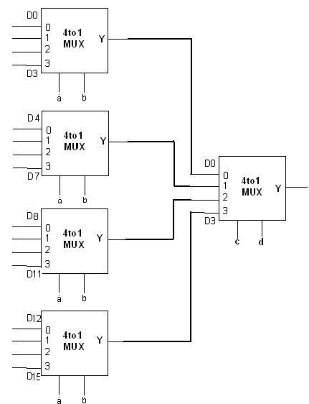
Design

Slide 8
Package and Entity Declaration
library ieee;
use ieee.std_logic_1164.all;
Entity mux_16_1 is
port( inps: in std_logic_vector(15 downto 0);
sel : in std_logic_vector(3 downto 0);
opt: out std_logic);
end mux_16_1;

Slide 9
Component and Signal Declaration
architecture str of mux_16_1 is
component mux_4_1 is
port( i0, i1, i2, i3: in std_logic;
sel: in std_logic_vector(1 downto 0);
opt: out std_logic);
end component;
signal m0_o, m1_o, m2_0, m3_0: std_logic;

Slide 10
Component Instantiation (Map by association)
-- Order of ports do not matter in this method
m0: mux_4_1 port map (sel => sel(1 downto 0), i0 => inps(0), i1 => inps(1), i2 => inps(2), i3 => inps(3), opt => m0_o);
m1: mux_4_1 port map (i0 => inps(4), i1 => inps(5), i2 => inps(6), i3 => inps(7), opt => m1_o, sel => sel(1 downto 0),);
m2: mux_4_1 port map (sel => sel(1 downto 0), i0 => inps(8), i1 => inps(9), i2 => inps(10), i3 => inps(11), opt => m0_o);
m3: mux_4_1 port map (sel => sel(1 downto 0), i0 => inps(12), i1 => inps(13), i2 => inps(14), i3 => inps(15), opt => m0_o);

Slide 11
Component Instantiation ( Map by position)
m4: mux_4_1 port map (m0_o, m1_o, m2_o, m3_o, sel(3 downto 2), opt);
end str;
-- Note here the order in which the ports were declared in component declaration will matter
-- This is a slightly easier (less time consuming) way but may be error prone in case complete caution is not taken

Slide 12
Exercise for Practice
Using the Half Adder you built, construct a full adder using the half adder (You may use a simple dataflow statement for the OR gate)
Using the constructed full adder, construct a 4 bit ripple carry adder

Slide 13
Thank You

